Slide 1
ELECTRONIC VOTING MACHINE USING 8051 MICROCONTROLLER
By
Karthik. G. S
Kiran Poojary
Kirthik. K
Kushal. S

Slide 2
Objectives:
1. Interfacing 16x2 LCD display with 8051 microcontroller.
2. Interfacing set of six tactile switches with 8051 microcontroller.
3. Interfacing LED with 8051 microcontroller.
4. Interfacing buzzer with 8051 microcontroller.

Slide 3
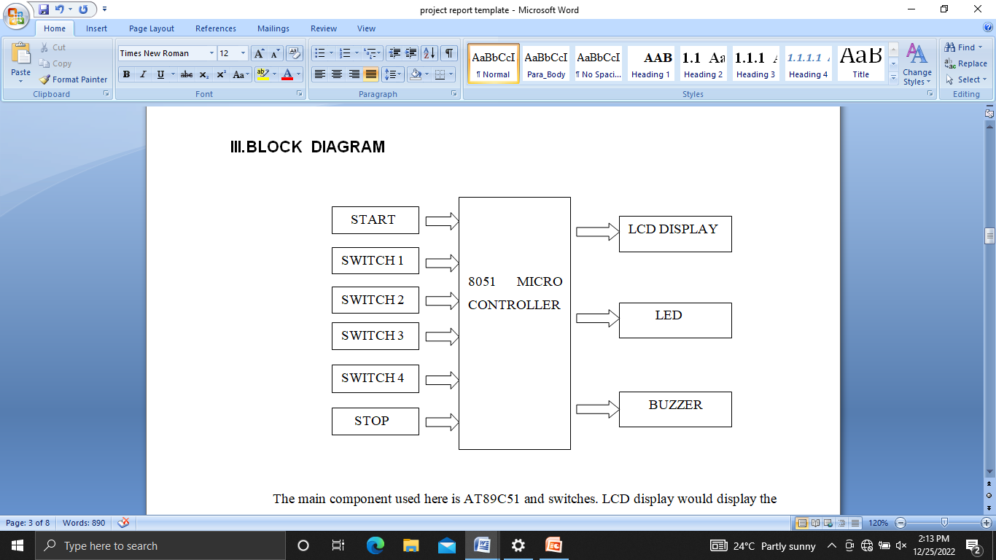
Block Diagram

Slide 4
Methodology
Objective 1: Interfacing 16x2 LCD display with 8051 microcontroller.
*The LCD display has 16 pins of which pin1 and pin2 are connected to ground and
VCC.
* Pin 3 which is the VEE pin is used to adjust the contrast of LCD , pin
4 is register select pin.
* Pin 5 is to read and write, pin 6 is enable, pins 7-14 are data pins respectively. The
data pins 7-14 are connected to port P2.0- port P2.7 of the microcontroller.
* The 4th,5th and 6th pin is connected to port P3.5, P3.6 and P3.7 of microcontroller.
* LCD is used to display the name of the candidate and the result only when the
stop switch is pressed

Slide 5
Methodology
Objective 2: Interfacing set of six tactile switches with 8051 microcontroller
* Four switches are interfaced to the port P1.1, P1.2, P1.3, P1.4 of the microcontroller through
which voter can cast his/her vote.
* Other two switches connected to the P1.0 and P1.5 of the controller are basically start and
stop buttons.
* At the beginning, the start button is to be pressed to start the voting process
* The voter can cast his/her vote to a particular candidate through switches.
* After the vote is casted, start button is to be pressed again before another voter casts his vote.
* Once the voting is completed, the stop button is to be pressed and result of the election is seen in
the LCD display.
.
.

Slide 6
Methodology
Objective 3: Interfacing LED with 8051 microcontroller.
* There are four LED’s interfaced with AT89C51 microcontroller.
* These LED’s are connected to port P0.0, P0.1, P0.2, P0.3 of the
AT89C51 microcontroller.
* These four LED’s are assigned to the four candidates.
* When the voter casts the vote, the associated LED would go high.

Slide 7
Methodology
Objective 4: Interfacing buzzer with 8051 microcontroller.
* The buzzer is interfaced to the port P0.7 of the microcontroller.
* The buzzer has got two terminals namely positive and negative which are connected to vcc and P0.7 respectively.
* Whenever voter votes to a particular candidate through tactile switches, the buzzer would buzz for some time indicating that the vote has been casted

Slide 8
List of the Components Required
Name | Description | unit price
Relimates | 8 pin and 4 pin | 5/-
AT89C51 Microcontroller | Microcontroller | 100/-
PCB | Printed Circuit Board. | 150/-
Tactile Switches | Used for voting purpose | 5/-
LED | Light Emitting Diode | 3/-
Buzzer | Would buzz when vote is casted | 5/-
Resistors and capacitors | 1k,3.3k,2.2k,10k,0.1uF,33pF, 150 pF, 10uF | 50/-
IC base | 40 pin IC base | 10/-
16x2 LCD display | Liquid Crystal Display | 180/-
Crystal Oscillator | 11.0592 MHz crystal oscillator | 20/-
Jumper wires | Used to connected various components | 5/-

